Slide 1


Sensitivity of Ozone to Emissions Changes
in the Great Lakes Region
Talat Odman, Yongtao Hu, Ted Russell
Mark Janssen, Tsengel Nergui, Angie Dickens, Zac Adelman
CMAS Conference 2022
Chapel Hill, NC
October 18, 2022

Slide 2
Motivation
Goal: Identify optimal surface ozone (O₃) mitigation strategies for nonattainment/maintenance areas in the LADCO region
Key Questions:
  How do O₃ concentrations at receptors respond to total nitrogen oxides (NO_{x}), volatile organic compounds (VOC), or NO_{x} and VOC emission reductions along a spectrum of 10% to 100%?
  … emissions reductions from different sectors?
  Which combination(s) of NO_{x}, VOC, and sector has the largest impact on peak O₃?
  What periods in the diel are most effective for sectorized emissions reductions?

Slide 3
Approach
Use the Comprehensive Air Quality Model with Extensions (CAMx) equipped with High-order Decoupled Direct Method (HDDM) to model the 1st and 2nd order sensitivity coefficients of O₃ concentrations to the emissions of NO_{x} and VOCs
Using those sensitivity coefficients, build reduced form models (RFMs)
  to assess how O₃ concentrations respond to changes in total anthropogenic NO_{x}/VOC emissions – construct O₃ isopleths for identifying alternative control paths
  to evaluate the impacts of sectorized and time-period emissions on peak O₃
  to assess how O₃ concentrations respond to sectorized NO_{x}/VOC emissions – evaluate controls for achieving a desirable future design value (DVF)
CAMx-HDDM
RFM
Ozone Isopleths
DVF

Slide 4
Brute Force vs. DDM-3D and HDDM-3D
CMAQ-HDDM modeling and analysis
C
A
C_{A}
+
∆C
B
α₁
C_{B}
+
E_{B}
Δε E_{A}
E
E_{A}
Notes:
Tools for addressing nonlinear response
Emphasize how 1st + 2nd order shows response along curve

Slide 5
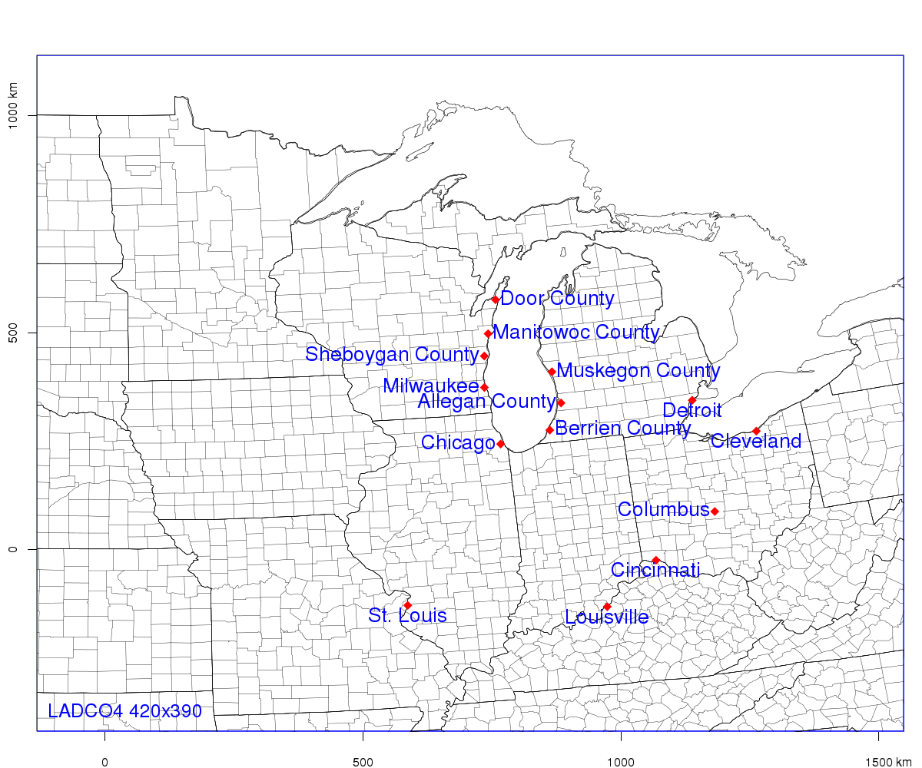
  Modeling Domain and Episodes
4-km resolution over the LADCO Region
14 Nonattainment or Maintenance Areas (NAA/MA)
3 high O₃ episodes selected:
  June 1-26, 2016
  July 19-23, 2016
  August 3-11, 2016

Slide 6
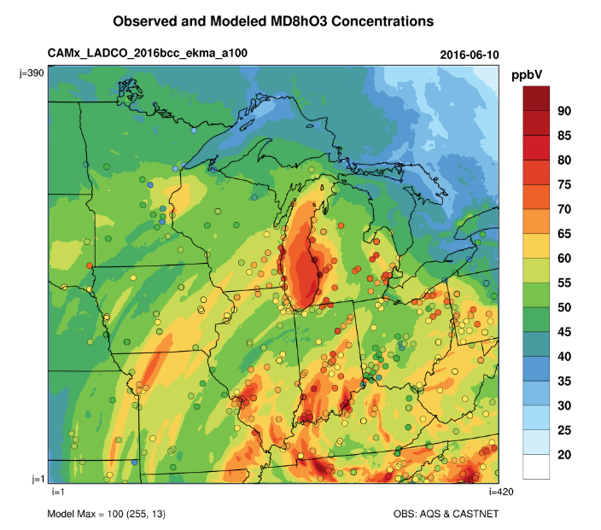
  Modeling Performance Evaluation
  Episodic MDA8 O₃ Performance (60ppb cutoff)
Episode | Obs(ppb) | Sim(ppb) | #Pairs | NMB(%) | NME(%)
June | 66.1 | 60.8 | 2305 | -8.1 | 11.3
July | 65.9 | 70.2 | 209 | 6.6 | 10.3
August | 67.0 | 69.1 | 368 | 3.8 | 10.4
Notes:
We evaluate MDA8 O₃ Performance for each NAA
We also examine MDA8 O3 spatial distribution maps with overlayed observations

Slide 7
  Emissions Source Group Sensitivity Modeling
Run-id | Base anthropogenic emissions | Emissions group* (NOx or VOCs) | Emissions group label
1 | 100% | total anthropogenic | a100
2 | 50% | total anthropogenic | a50
3 | 10% | total anthropogenic | a10
4 | 100% | onroad gasoline | ongas
5 | 100% | onroad diesel | ondie
6 | 100% | nonroad | nonrd
7 | 100% | volatile chemical products | vcp
8 | 100% | other non-point | othnpt
9 | 100% | EGU points | egu
10 | 100% | non-EGU points | othpt
11 | 100% | Canada sources | can
Label | HDDM Parameters
N | first-order sensitivity to NO_{x} emissions
V | first-order sensitivity to VOCs emissions
NN | second-order sensitivity to NO_{x} emissions
VV | second-order sensitivity to VOCs emissions
NV | cross second-order sensitivity to NO_{x} and VOCs emissions

Slide 8
  Emission Time Period Sensitivity Modeling
Run-id | DDM emissions groups | DDM Parameters
1 | onroad gasoline NOx, onroad diesel NOx, nonroad NOx, EGU points NOx, and non-EGU points NOx | 1st order sensitivity to NOx from 6-9 EDT (early AM)
2 |  | 1st order sensitivity to NOx from 10-12 EDT (late AM)
3 |  | 1st order sensitivity to NOx from 13-15 EDT (early PM)
4 |  | 1st order sensitivity to NOx from 16-19 EDT (late PM)
5 |  | 1st order of NOx from 20-22 EDT (evening)
6 |  | 1st order of NOx from 23-5 EDT (night)
7 | onroad gasoline VOCs, onroad diesel VOCs, nonroad VOCs, volatile chemical products VOCs, other non-point VOCs, and non-EGU points VOCs | 1st order of VOC from 6-9 EDT (early AM)
8 |  | 1st order of VOC from 10-12 EDT (late AM)
9 |  | 1st order of VOC from 13-15 EDT (early PM)
10 |  | 1st order of VOC from 16-19 EDT (late PM)
11 |  | 1st order of VOC from 20-22 EDT (evening)
12 |  | 1st order of VOC from 23-5 EDT (night)
* Only for two short high-ozone episodes (June 9-13 and July 19-23)

Slide 9
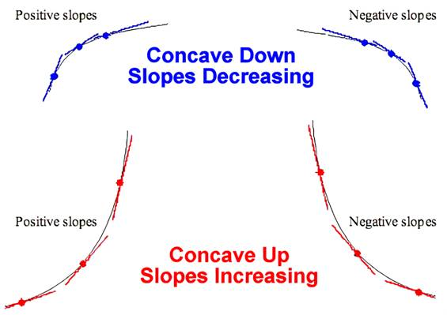




Interpretation of 1st and 2nd order sensitivities
$$S^{(1)}>0$$
$$S^{(1)}<0$$
$$S^{(2)}<0$$
  Ozone Conc.
$$S^{(2)}>0$$
  Emissions

Slide 10
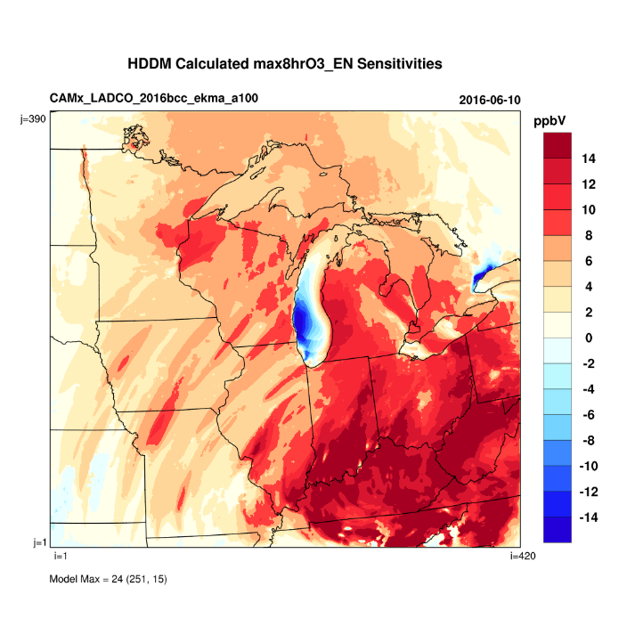
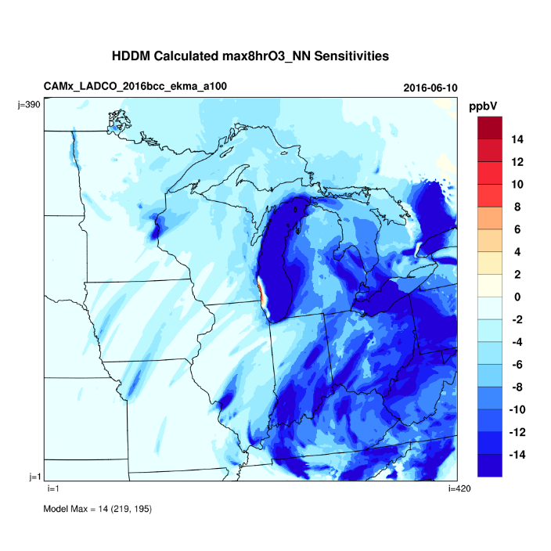
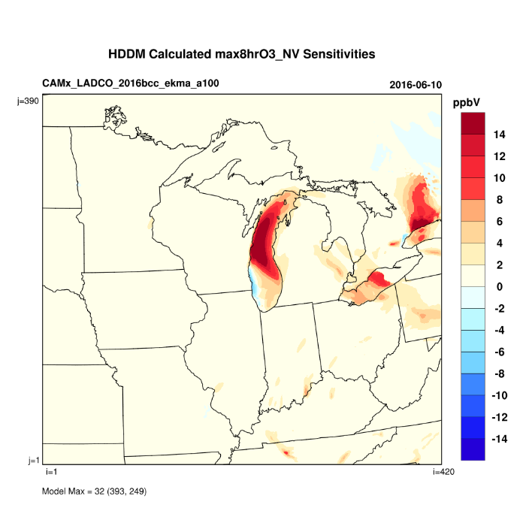
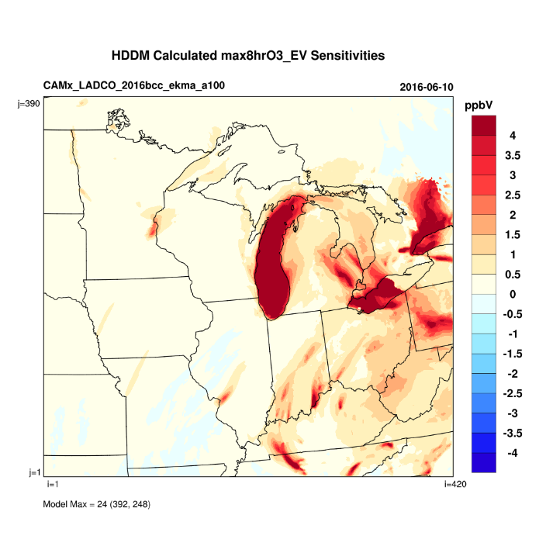
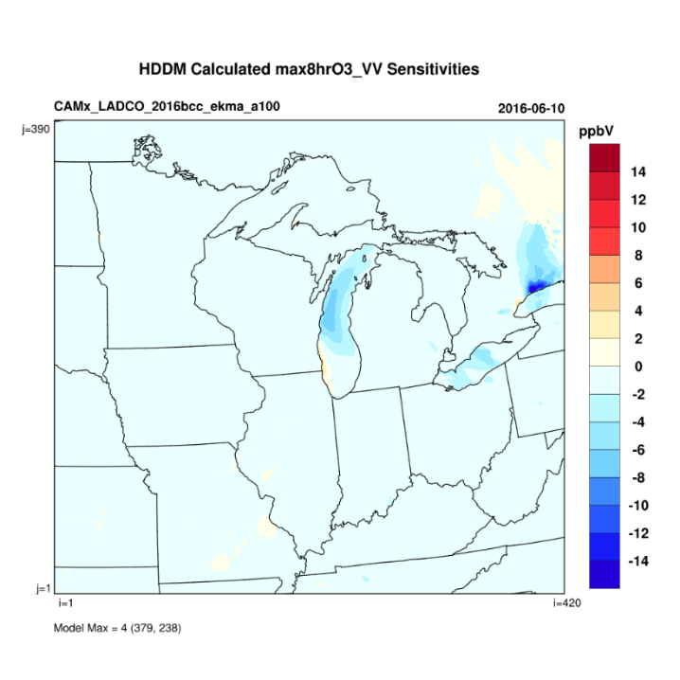
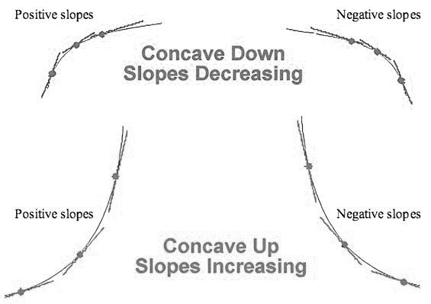
  Sensitivity Modeling Results: at 100% total emissions
  N
14
  NN
14
  NV
14
  V
4
  VV
14
  Ozone Conc.
  Emissions

Slide 11
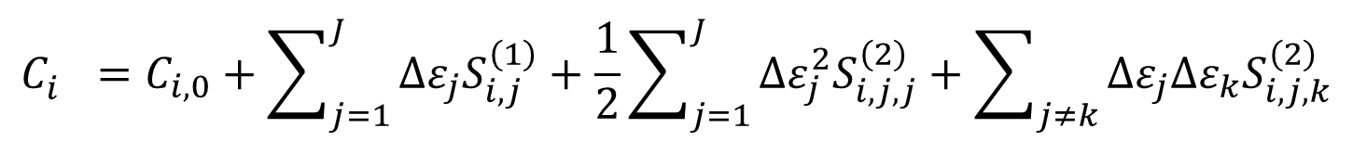
  Reduced Form Model (RFM) and its Applications
RFM can be built using receptor-specific HDDM sensitivities to calculate ozone concentrations corresponding to NOx/VOC emissions changes
  N or V sensitivity
  NN or VV sensitivity
  NV sensitivity
$$C_{i}^{}=C_{i,0}+\sum_{j=1}^{J}{∆ε_{j}S_{i,j}^{\left(1\right)}}+\frac{1}{2}\sum_{j=1}^{J}{∆ε_{j}^{2}S_{i,j,j}^{\left(2\right)}}+\sum_{j≠k}{∆ε_{j}∆ε_{k}S_{i,j,k}^{\left(2\right)}}$$
  NOx/VOC emissions change
  ozone concentration at the current emissions level
  ozone concentration at the changed emissions level
Application 1: construct receptor and date specific MDA8 ozone isopleths
Application 2: calculate Future Design Value (DVF) for control design

Slide 12
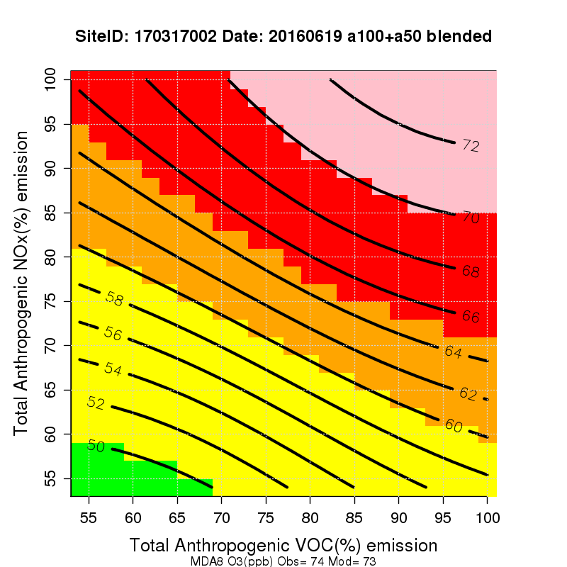
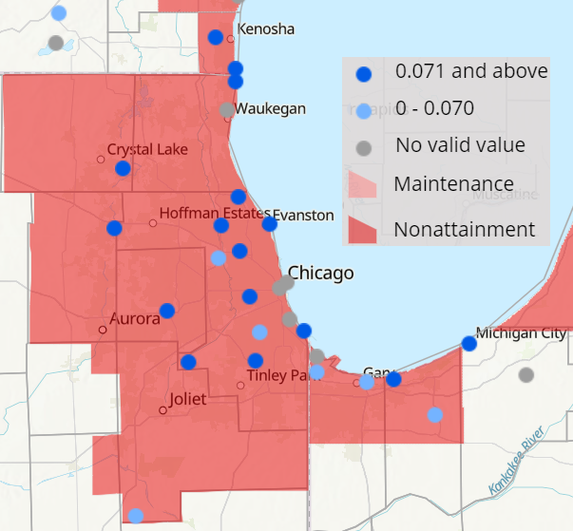
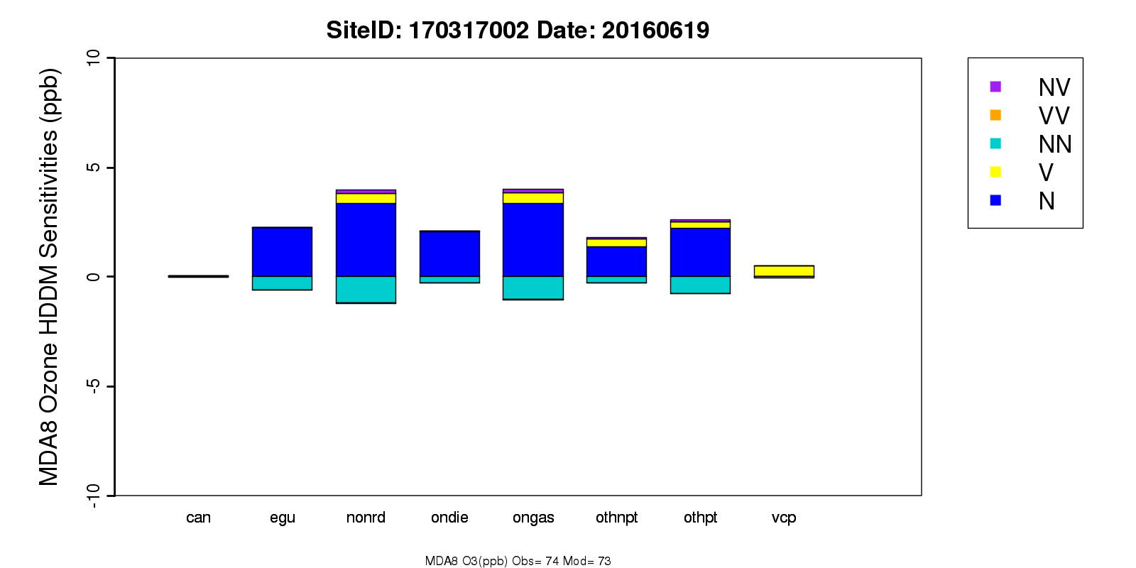
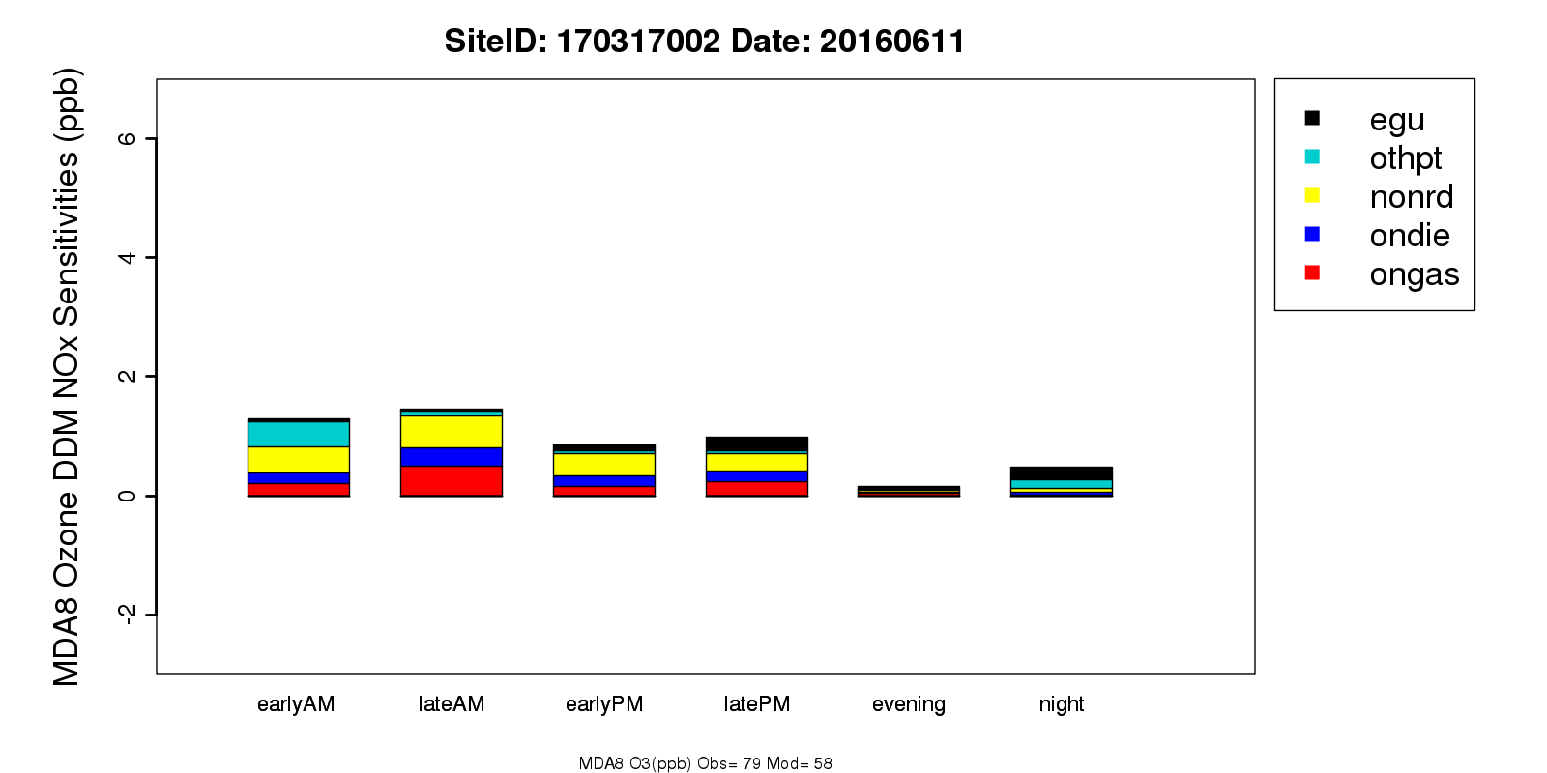
  Chicago, IL-IN-WI NAA
  at select site 170317002
  (Water Plant, IL)
  on select date 20160619
  Obs = 74 ppb
  Sim = 73 ppb
  MDA8 Ozone Isopleths
  (suggested control path follows a line with NOx:VOC between 7:1 and 8:1)
  170314002
  (Cook County Trailer, IL)
  Sectorized HDDM Sensitivities
  NO_{x} Emission Time Period Sensitivities
Notes:
Reductions of NOx emissions from the nonroad, onroad gasoline, non-EGU point, EGU point, and onroad diesel sources combined would decrease O₃ significantly.
Controlling NOx emissions from the nonroad, onroad gasoline and onroad diesel sources during late morning and controlling the NOx emissions from the non-EGU point and nonroad sources during early morning are more efficient in decreasing MDA8 O₃ concentrations.

Slide 13
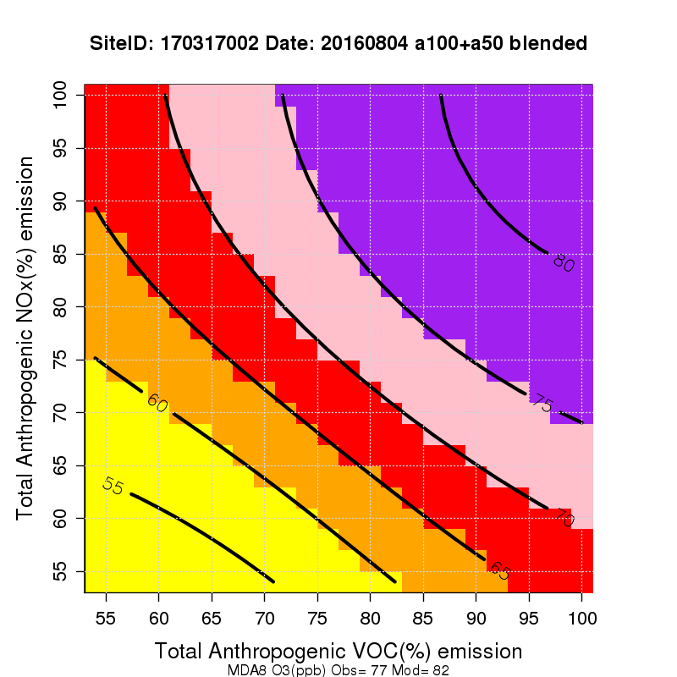
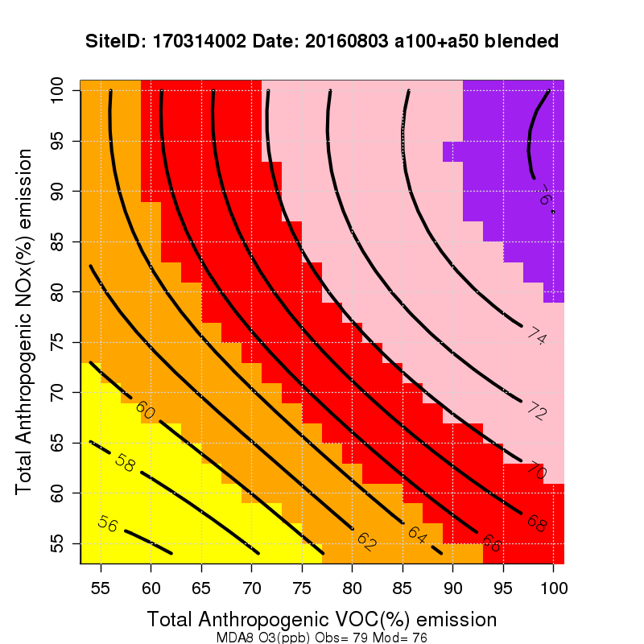
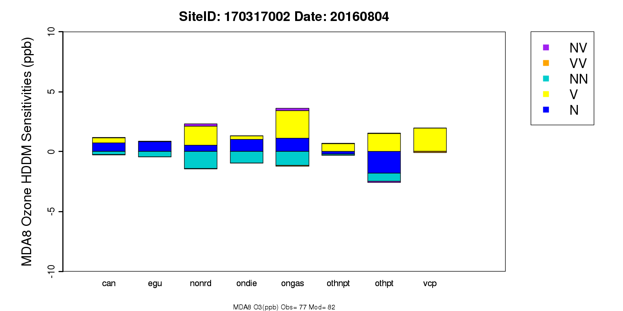
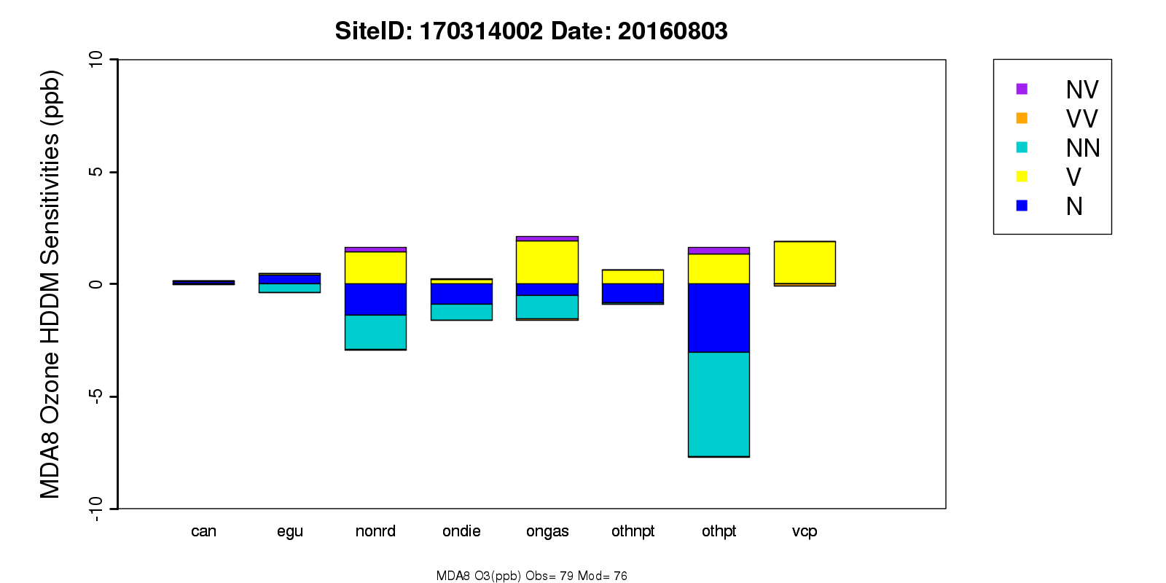
  Chicago, IL-IN-WI NAA
  170317002 (Water Plant, IL)
  on 20160804
  Obs = 77 ppb, Sim = 82 ppb
  MDA8 Ozone Isopleths
  (suggested control NOx:VOC about 1:1)
  170314002 (Cook County Trailer, IL)
  on 20160803
  Obs = 79 ppb, Sim = 76 ppb
  MDA8 Ozone Isopleths
  (suggested control NOx:VOC about 1:8)
  Sectorized HDDM Sensitivities
  Sectorized HDDM Sensitivities
Notes:
At site 170317002 (Water Plant, IL) on 20160804, VOC emissions from sources of onroad gasoline, VCP, nonroad, and non-EGU point are more important.
At site 170314002 (Cook County Trailer, IL) on 20160803, VOC emissions from sources of onroad gasoline, VCP, nonroad, and non-EGU point are more important.

Slide 14
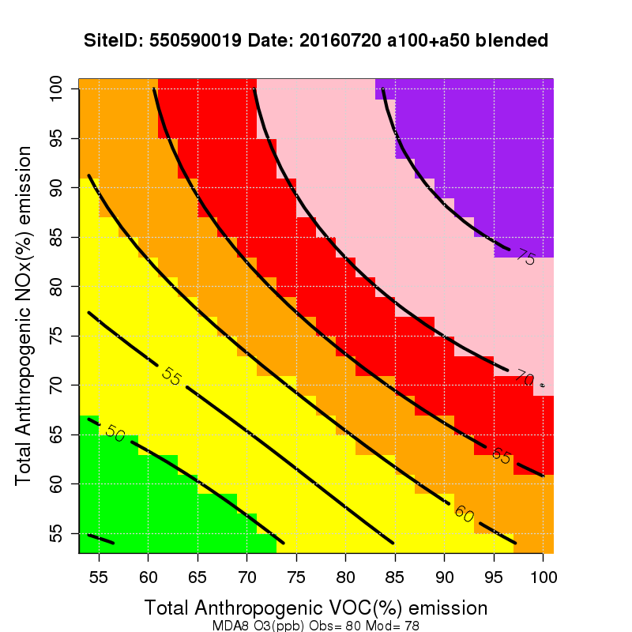
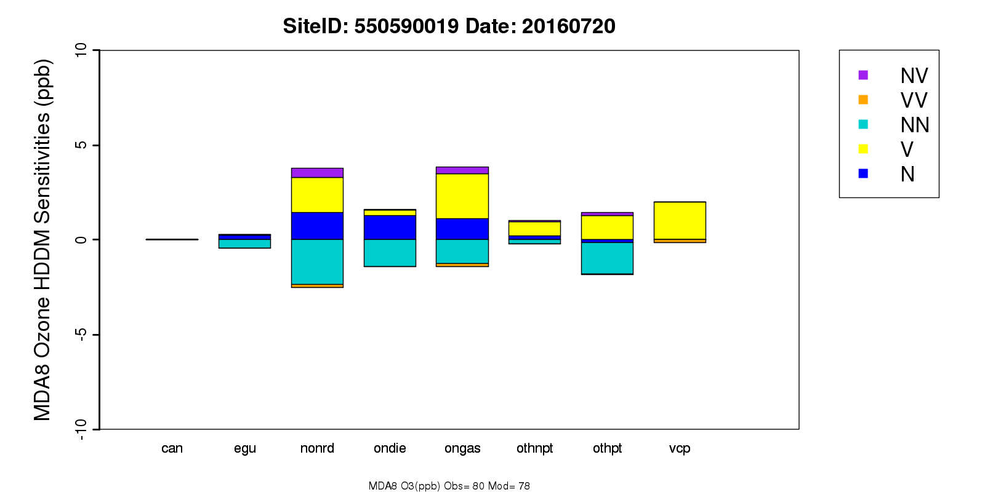
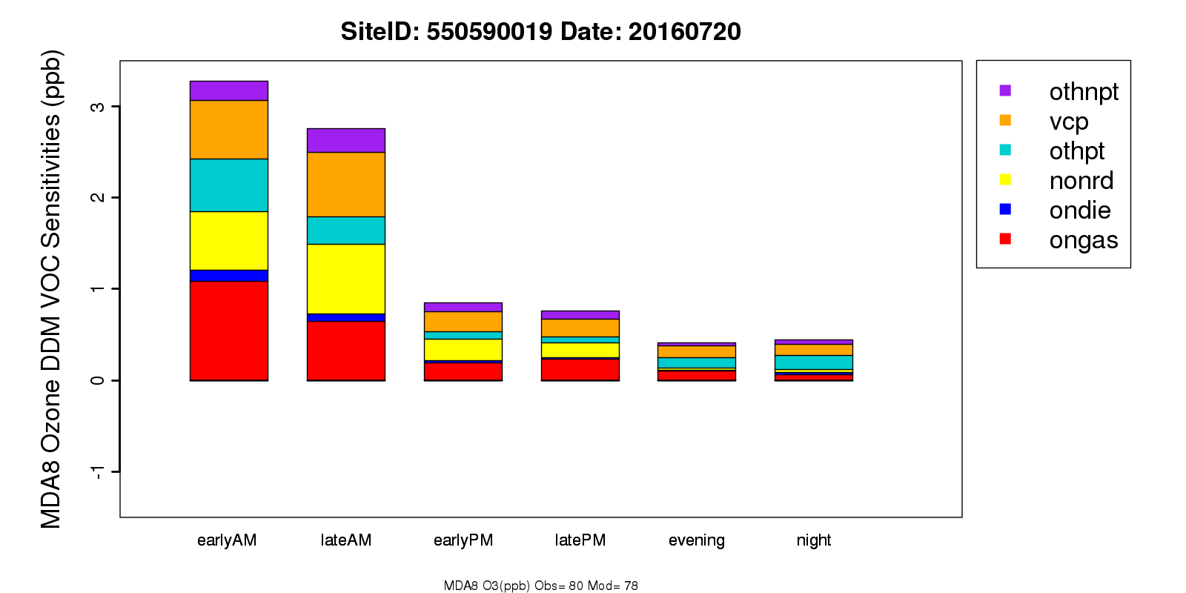
  Chicago, IL-IN-WI NAA
  at select site 550590019
  (Chiwaukee Prairie, WI)
  on select date 20160720
  Obs = 80 ppb
  Sim = 78 ppb
  MDA8 Ozone Isopleths
  (suggested control path follows a line with NOx:VOC about 1:1 and 1:2)
  Sectorized HDDM Sensitivities
  VOC emission
  Time Period Sensitivities
Notes:
Reductions of VOC emissions from onroad gasoline, nonroad, VCP and non-EGU point, combined with reductions of NOx emissions from the nonroad, onroad diesel and onroad gasoline sources would decrease O₃ significantly.
Controlling NOx/VOC emissions from the above sources during early and late morning are more efficient in decreasing MDA8 O₃ concentrations.

Slide 15
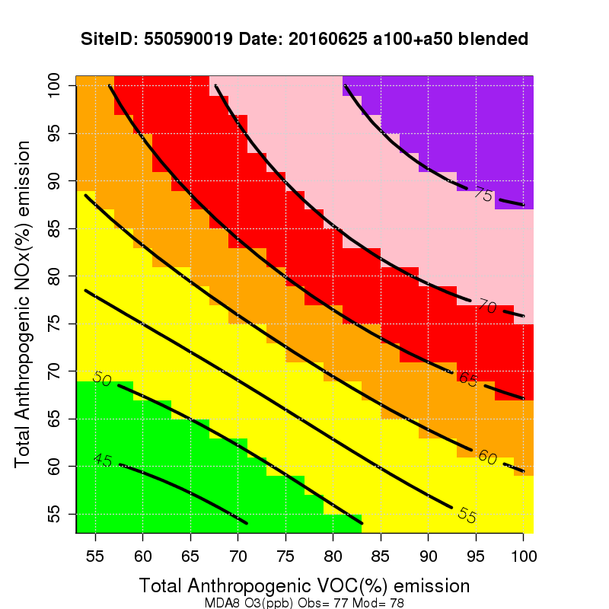
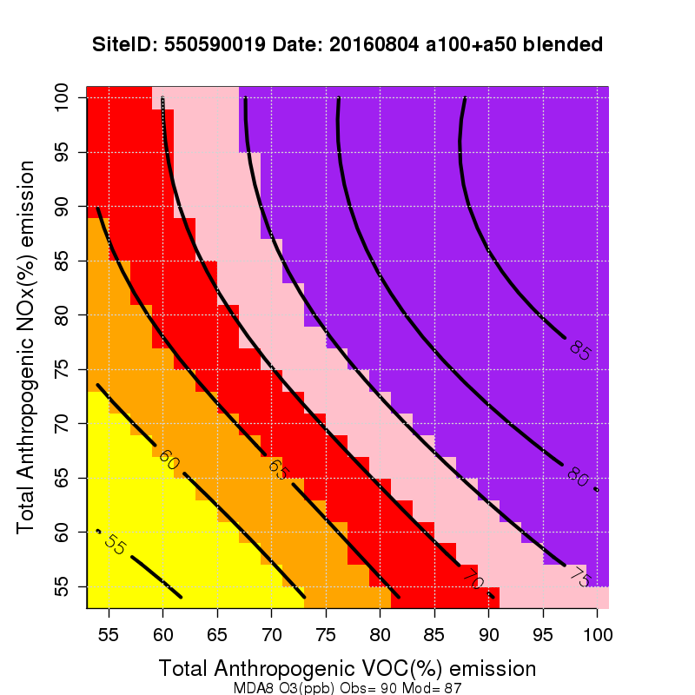
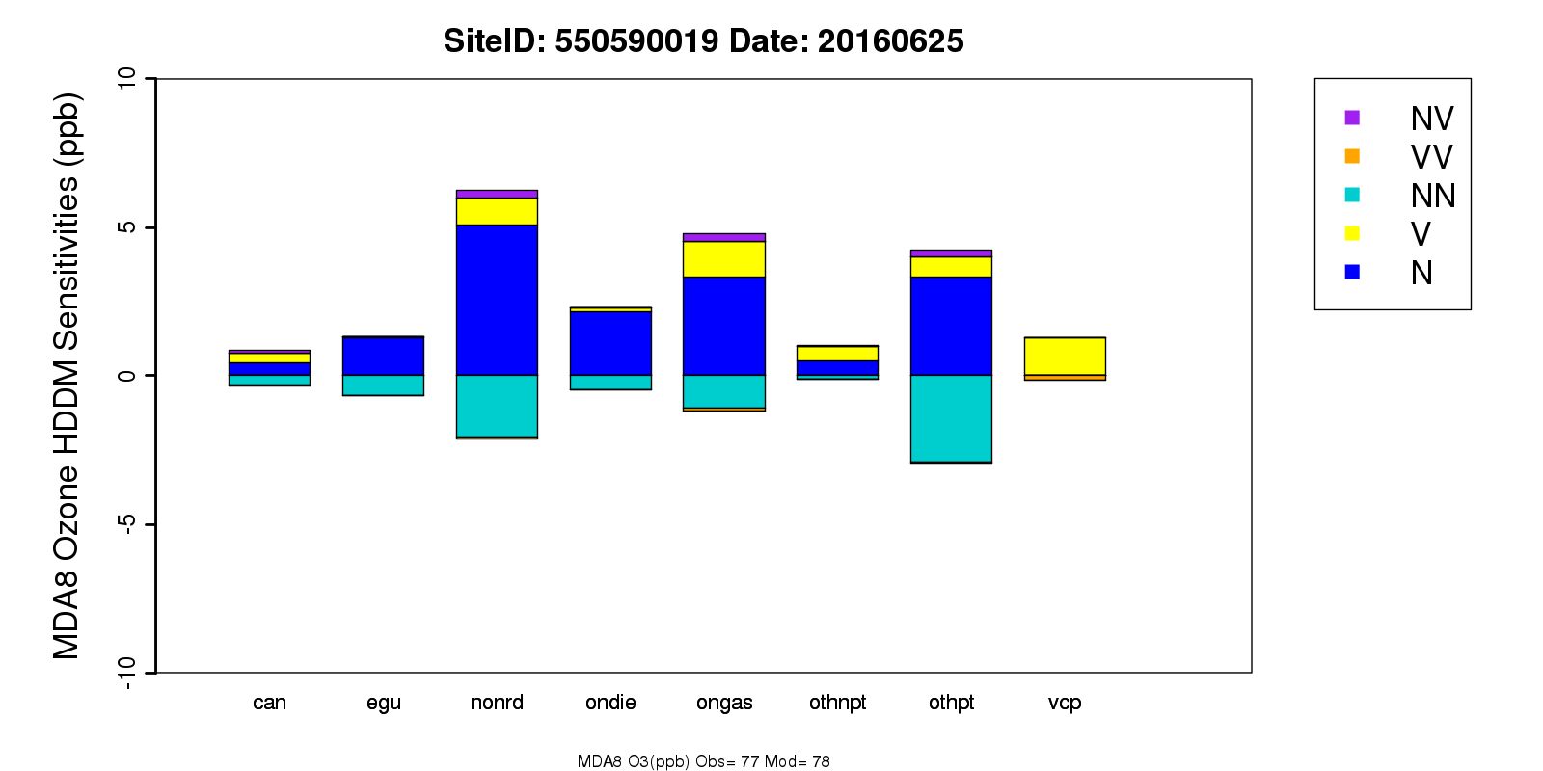
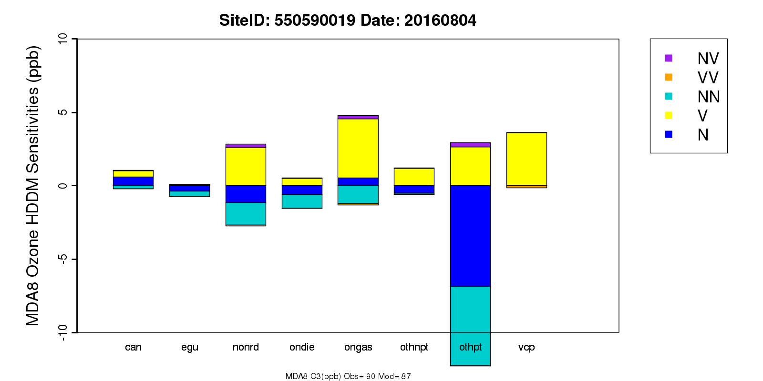
  Chicago, IL-IN-WI NAA
  550590019 (Chiwaukee Prairie, WI)
  on 20160625
  Obs = 77 ppb, Sim = 82 ppb
  MDA8 Ozone Isopleths
  (suggested control NOx:VOC about 2:1)
  on 20160804
  Obs = 77 ppb, Sim = 82 ppb
  MDA8 Ozone Isopleths
  (suggested control NOx:VOC about 1:8)
  Sectorized HDDM Sensitivities
  Sectorized HDDM Sensitivities
Notes:
At this site on 20160625, NOX emissions from sources of nonroad, non-EGU point, onroad gasoline, and onroad diesel are more important.
At this site on 20160804, VOC emissions from sources of onroad gasoline, VCP, nonroad, and non-EGU point are more important.

Slide 16
Summary of Findings
With just three sets of sensitivity coefficients at 100%, 50% and 10% of total anthropogenic emissions, we could not estimate O₃ response for the full range of emission reductions.
We produced O₃ isopleths covering a range of zero to 45% NO_{x} and VOC emissions reductions. More information is needed at the lower emissions levels.
Effective control paths are receptor / date dependent.
For an exceedance at a specific receptor / on a specific date, it is possible that
  NOx controls are more effective,
  VOC controls are more effective or
  NOx & VOC controls are both effective.
Controlling certain emission sectors may be more effective
Controlling emissions during certain time periods in the diel may be more effective.
For more detailed results, please see our Final Report at http://semap.ce.gatech.edu/LADCO/LADCO_Project_Final_Report_V4.pdf

Slide 17
Thanks!
Questions? odman@gatech.edu

Slide 18
Backup Slides

Slide 19
  Spreadsheet to calculate DVF with user input sector specific reductions

Slide 20
  Sensitivity Analysis Summary (1)
  Effective control paths are receptor/date dependent. For an exceedance with specific receptor/date, it can be either (1) NOx controls are more effective, or (2) VOC controls are more effective, or (3) NOx & VOC controls are both effective.
Area | Typical Optimal NOx/VOC Emissions Control Path on Exceedances | Typical Largest Sectorized Emissions Contributors to MDA8 O3 Mitigation | Typical Emission Periods with Largest Impact on MDA8 O3 Mitigation
Chicago, IL-IN-WI, inland and coastal | A mix of the three, but NOx controls are more effective | nonroad, onroad gasoline and non-EGU point | late and early morning
Chicago, IL-IN-WI, far north | A mix of the three, but NOx & VOC are more effective | onroad gasoline, volatile chemical products, nonroad | early and late morning
St. Louis, IL-MO | In general, NOx controls are more effective, with a few NOx & VOC | onroad diesel, onroad gasoline, nonroad and EGU point | late morning and early afternoon, and early morning for EGU
Louisville, IN-KY | NOx controls are more effective, with a few VOC and NOx & VOC | EGU point, onroad diesel, onroad gasoline | late morning and early morning
Cincinnati, OH-KY | NOx controls are more effective, with occasional NOx & VOC | onroad gasoline, nonroad, onroad diesel | late morning and early afternoon
Columbus, OH | In general, NOx controls are more effective, with a few NOx & VOC | onroad gasoline, nonroad, EGU point, onroad diesel | late morning and early afternoon, night and early morning for EGU
Cleveland, OH | In general, NOx controls are more effective, with a few NOx & VOC | nonroad, onroad gasoline, onroad diesel | late morning and early afternoon

Slide 21
  Sensitivity Analysis Summary (2)
Area | Typical Optimal NOx/VOC Emissions Control Path on Exceedances | Typical Largest Sectorized Emissions Contributors to MDA8 O3 Mitigation | Typical Emission Periods with Largest Impact on MDA8 O3 Mitigation
Detroit, MI | NOx controls are more effective, with occasional NOx & VOC | nonroad, onroad gasoline, non-EGU point | early morning and late morning
Berrien County, MI | NOx controls are more effective | nonroad, onroad diesel, onroad gasoline | late morning and early afternoon
Allegan County, MI | NOx controls are more effective | nonroad, onroad diesel, onroad gasoline | late morning and early afternoon
Muskegon County, MI | NOx controls are more effective | nonroad, onroad diesel, onroad gasoline | late morning and early afternoon
Milwaukee, WI | A mix of the three, but NOx & VOC are more effective | onroad gasoline, volatile chemical products, nonroad | early morning, late morning and night
Sheboygan County, WI | Mostly NOx & VOC, but NOx and VOC controls are also effective | onroad gasoline, volatile chemical products, nonroad | early morning and late morning
Manitowoc County, WI | Mostly NOx & VOC, but NOx and VOC controls are also effective | volatile chemical products and onroad gasoline (VOC), nonroad, onroad diesel (NOx) | early morning, late morning and night
Door County, WI | NOx controls are more effective, with occasional NOx & VOC | nonroad and onroad gasoline (NOx) volatile chemical products (VOC) | early morning

